Slide 1



Pillai HOC College of Engineering and Technology ( Autonomous )
TEAM NAME:
PIXEL’s
COLLEGE NAME:
AITM, KANPUR & PSIT, KANPUR
STATE :
UTTAR PRADESH
TEAM MEMBERS:
  Yash Dubey, LEADER, AITM
  Harsh Kumar, AITM
  Gopal JI Dwivedi, AITM
  Sumit Singh, PSIT
1

Slide 2



PROBLEM STATEMENT
Problem
  Drug discovery is slow, expensive, and highly trial-and-error driven.
  Existing computational tools struggle with limited molecular diversity, slow exploration, and poor usability.
Who is affected ?
Why this matters?
  Pharmaceutical researchers.
  Drug discovery labs.
  Biotech startups.
  Traditional pipelines take 10–15 years with high failure rates.
  Early-stage molecule screening is a major bottleneck.
Limitations of existing solutions
  AI models generate invalid or low-novelty molecules.
  Academic models lack practical research workflows.
  Fragmented tools for generation, evaluation, and comparison.
Pillai HOC College of Engineering and Technology ( Autonomous ) 2

Slide 3
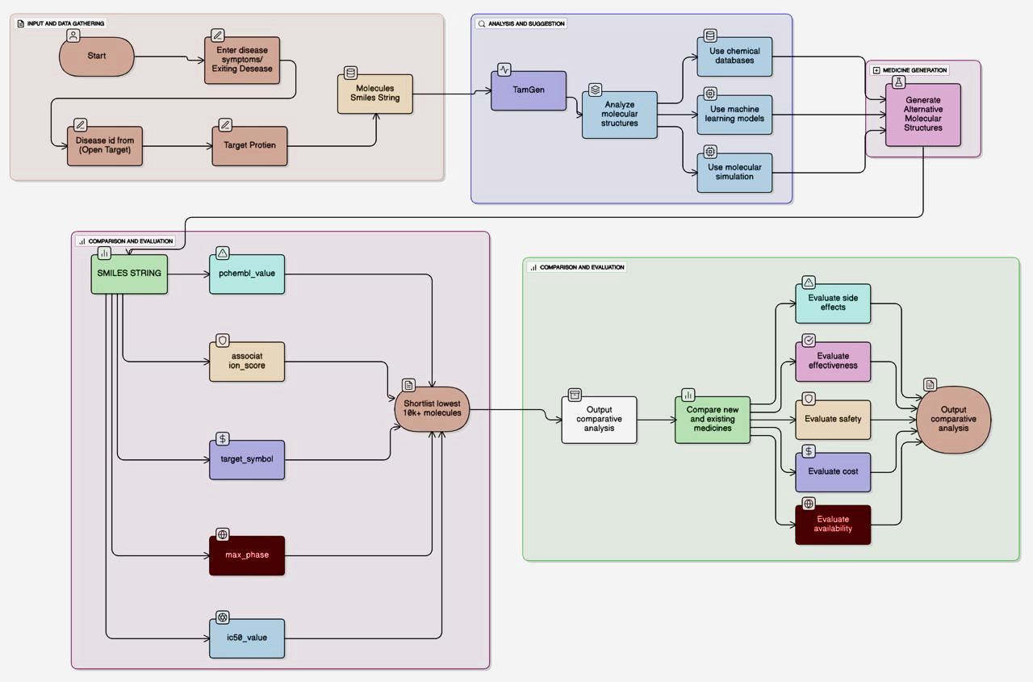
PROPOSED SOLUTION
  Disease and Target Protein Identification Identify target proteins from biological databases using specific disease information.
  SMILES-Based Molecular Data Retrieval Retrieve existing drug molecules and represent them using SMILES chemical strings.
  AI-Driven De Novo Molecule Generation Generate novel candidate molecules by analyzing patterns with generative AI models.
  Multi-Parameter Evaluation and Shortlisting Evaluate thousands of candidates based on binding affinity and clinical data.
  Comparative Analysis and Ranking Rank optimized candidates against existing medicines for safety and overall effectiveness.
Pillai HOC College of Engineering and Technology ( Autonomous ) 3

Slide 4





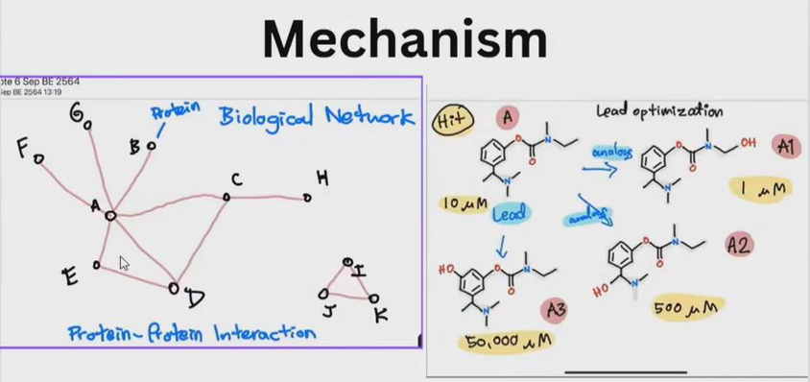
TECHNICAL APPROACH
Technologies to be used:
  Backend: Python
  Molecular processing: RDKit
  Generative model: TangGen
  Predictive models: Multiple independent ML models
  Frontend: Web-based research dashboard
Methodology / Process:
  Disease & target protein identification
  SMILES-based molecular retrieval
  De novo molecule generation
  Multi-model evaluation
  Filtering, comparison, and ranking
Pillai HOC College of Engineering and Technology ( Autonomous ) 4

Slide 5



IMPACT AND BENEFITS
Impact :
  Accelerates early-stage drug discovery.
  Supports researchers with faster candidate exploration.
Target users :
Benefits :
  Drug discovery researchers.
  Academic labs.
  Early-stage pharma R&D teams.
  Saves time in molecular screening.
  Improves chemical diversity and validity.
  Multi-factor evaluation beyond structural similarity.
  Practical, researcher-friendly interface.
Pillai HOC College of Engineering and Technology ( Autonomous ) 5

Slide 6
RESEARCH AND REFERENCES
  https://www.drugpatentwatch.com
  https://www.rsc.org
  https://arxiv.org/search/?query=transformer+molecular+generation&searchtype=all
  https://www.ebi.ac.uk/chembl/
  https://www.opentargets.org
  https://iclr.cc
Pillai HOC College of Engineering and Technology ( Autonomous ) 6

